Slide 1
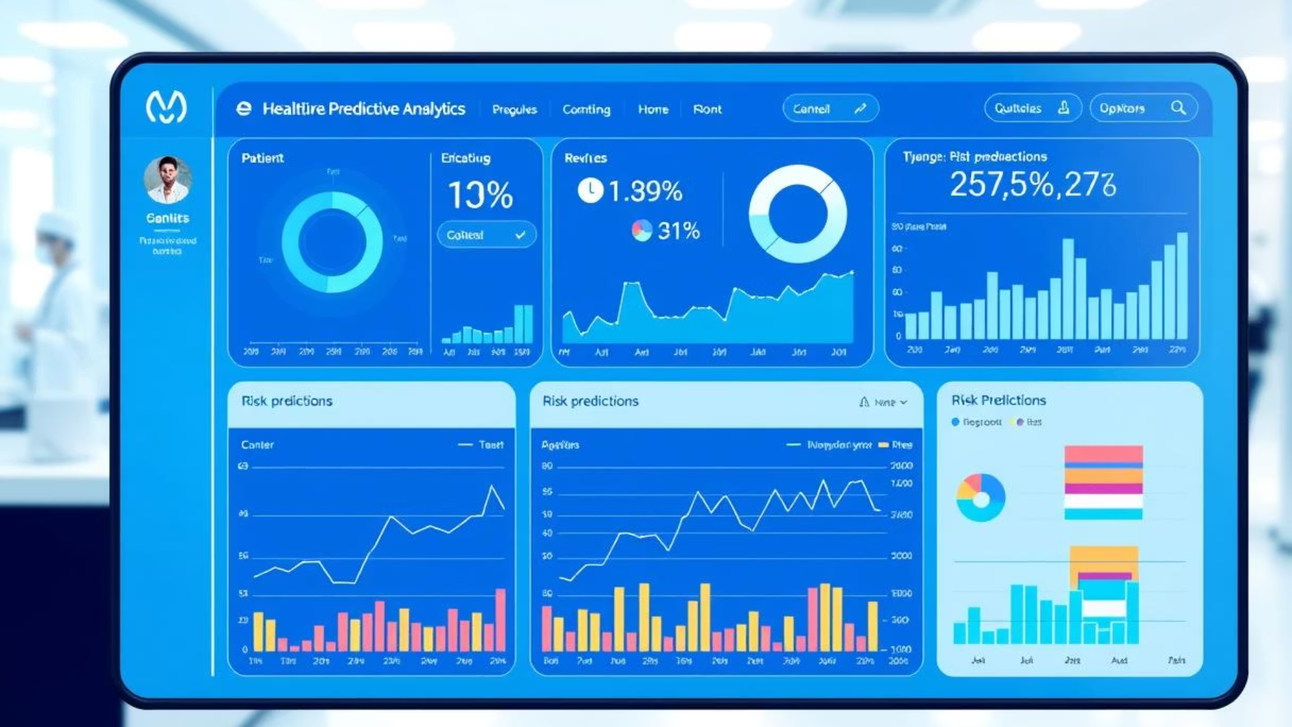

Healthcare Predictive Analytics Project
The Healthcare Predictive Analytics project focuses on developing a predictive model to improve healthcare outcomes by providing data-driven insights. The model will be designed to help healthcare professionals with tasks such as patient risk prediction, trend identification in health metrics, and making informed decisions based on predictive analytics. The project will utilize machine learning models to forecast healthcare-related outcomes, focusing on improving patient care and resource management.
by Hassan El-zainy

Slide 2





Project Overview
The Healthcare Predictive Analytics project focuses on developing a predictive model to improve healthcare outcomes by providing data-driven insights. The model will be designed to help healthcare professionals with tasks such as patient risk prediction, trend identification in health metrics, and making informed decisions based on predictive analytics. The project will utilize machine learning models to forecast healthcare-related outcomes, focusing on improving patient care and resource management.
Data Collection, Exploration, and Preprocessing
Collect relevant healthcare data, explore the dataset for trends, and preprocess it for further modeling.
Data Analysis and Visualization
Perform in-depth data analysis and generate insights through visualizations to aid in healthcare decision-making.
Predictive Model Development and Optimization
Develop and optimize machine learning models to predict healthcare outcomes, such as patient risk prediction.
MLOps, Deployment, and Monitoring
Implement MLOps for tracking model performance and deploy the predictive model for real-world healthcare applications.
Final Documentation and Presentation
Finalize the documentation and present the results to healthcare stakeholders, demonstrating the model's value.

Slide 3
Milestone 1: Data Collection, Exploration, and Preprocessing
Objectives:
Collect relevant healthcare data, explore the dataset for trends, and preprocess it for further modeling.
Data Collection
Data Exploration
Data Preprocessing
Obtain healthcare datasets (e.g., patient records, clinical data, or health metrics) that contain key features like age, medical history, test results, treatments, and patient outcomes.
Conduct exploratory data analysis (EDA) to understand the structure of the dataset.
Handle missing data using techniques such as imputation or removal.
Normalize or standardize data for model compatibility.
Identify key features, the distribution of health-related data points, and any potential patterns.
Encode categorical variables if necessary (e.g., encoding medical conditions or diagnoses).
Ensure the dataset contains relevant health information and is structured for predictive modeling.
Identify missing values, inconsistencies, and outliers.
Deliverables:
Dataset Exploration Report: A report that summarizes the data's characteristics, distribution of features, and any data quality issues discovered.
EDA Notebook: A Jupyter notebook with visualizations and summary statistics such as histograms, boxplots, and heatmaps.
Cleaned Dataset: A processed dataset ready for use in further analysis and modeling.

Slide 4



Milestone 2: Data Analysis and Visualization
Objectives:
Perform in-depth data analysis and generate insights through visualizations to aid in healthcare decision-making.
Data Cleaning
Continue the cleaning process by addressing any remaining missing values, outliers, and inconsistencies.
Normalize or apply transformations to ensure the data is model-ready.
Data Analysis
Analyze relationships between health metrics and outcomes (e.g., the risk of disease or patient recovery).
Use statistical methods such as correlation analysis, hypothesis testing, or feature importance analysis to identify key factors affecting healthcare outcomes.
Data Visualization
Create compelling visualizations like heatmaps, trend lines, and scatter plots to highlight trends, outliers, and significant patterns in health metrics.
Develop interactive dashboards or charts (using tools like Plotly, Dash, or Tableau) to enable stakeholders to easily view and interpret the data.
Deliverables:
Cleaned Dataset and Analysis Report: A detailed report outlining the data cleaning steps, analysis results, and insights gained from health metrics.
Visualizations of Health Trends: Interactive charts and dashboards that visually represent health trends, anomalies, and prediction insights.

Slide 5

Milestone 3: Predictive Model Development and Optimization
Objectives:
Develop and optimize machine learning models to predict healthcare outcomes, such as patient risk prediction.
1
Model Selection
Choose suitable machine learning algorithms based on the nature of the problem (e.g., Logistic Regression, Random Forest, Gradient Boosting, Neural Networks). Consider both supervised models (for classification or regression tasks) and unsupervised models (for clustering or anomaly detection) depending on the data and goals.
2
Model Training
Split the data into training and testing sets, ensuring proper time-series validation (if applicable). Train models on the training data and evaluate their performance on the test set. Use cross-validation to assess model generalization and avoid overfitting.
3
Model Evaluation
Use relevant evaluation metrics for the models, such as accuracy, precision, recall, F1-score, ROC-AUC for classification models. Evaluate confusion matrices to understand model performance on false positives and false negatives.
4
Model Optimization
Use hyperparameter tuning methods such as Grid Search or Random Search to optimize model performance. Fine-tune the models to increase prediction accuracy and avoid overfitting.
Deliverables:
Predictive Model Performance Report: A detailed report summarizing the performance of various models, evaluation metrics, and the final model selection.
Model Code: Python code used to develop, train, and evaluate the predictive models.
Final Model: The optimized predictive model selected based on evaluation metrics and its suitability for healthcare predictions.

Slide 6




Milestone 4: MLOps, Deployment, and Monitoring
Objectives:
Implement MLOps for tracking model performance and deploy the predictive model for real-world healthcare applications.
Model Deployment
MLOps Implementation
Deploy the model as a REST API or web application using frameworks like Flask or FastAPI. Make the model accessible for healthcare professionals to input patient data and receive predictions. Optionally, deploy to cloud platforms like Heroku, Google Cloud, or AWS to ensure scalability.
Use tools like MLflow or Kubeflow to manage model experiments, track metrics, and ensure reproducibility of results. Maintain version control for models and datasets to facilitate updates and deployments.
Performance Reporting
Model Monitoring
Generate periodic reports on model performance, making sure that the model continues to deliver accurate predictions over time.
Set up continuous monitoring to detect model drift or performance degradation over time. Implement automated alerts for retraining or updating models based on incoming data or decreased accuracy.
Deliverables:
Deployed Predictive Model: A live predictive model deployed as a web service or API, capable of making real-time healthcare predictions.
MLOps Report: A comprehensive report describing the tools and strategies used for managing the model lifecycle, including experiment tracking, deployment, and monitoring.
Model Monitoring Setup: Documentation outlining the model monitoring processes and how performance is tracked and maintained.

Slide 7
Milestone 5: Final Documentation and Presentation
Objectives:
Finalize the documentation and present the results to healthcare stakeholders, demonstrating the model's value.
Final Report
Final Presentation
Summarize the entire project, including data collection, preprocessing, model development, and deployment.
Create a concise and engaging presentation for healthcare stakeholders, showcasing the predictive model's functionality and real-world impact.
Discuss challenges faced during the project and key insights gained from the predictive model.
Discuss the model's ability to predict patient risk, identify trends in health data, and assist healthcare professionals in decision-making.
Provide recommendations for how healthcare professionals can integrate the model into their workflow to improve patient outcomes.
Highlight potential future improvements and how the model can evolve with more data and integration into healthcare systems.
Deliverables:
Final Project Report: A comprehensive document summarizing all aspects of the project, including the model's impact on healthcare outcomes.
Final Presentation: A visually engaging presentation suitable for healthcare stakeholders, demonstrating the model's functionality and business implications.

Slide 8

Final Milestones Summary and Conclusion
Milestone
Key Deliverables
1. Data Collection, Exploration & Preprocessing
EDA Report, Interactive Visualizations, Cleaned Dataset
2. Data Analysis, Visualization & Feature Engineering
Data Analysis Report, Visualizations of Health Trends, Feature Engineering Summary
3. Model Development & Optimization
Model Evaluation Report, Model Code, Final Model
4. MLOps, Deployment & Monitoring
Deployed Model, MLOps Report, Monitoring Setup
5. Final Documentation & Presentation
Final Project Report, Final Presentation
Conclusion:
The Healthcare Predictive Analytics project leverages machine learning to predict patient risks and health outcomes, offering valuable insights that healthcare professionals can use for improving patient care. By focusing on data exploration, predictive modeling, and deployment, this project ensures the development of a functional and scalable system for healthcare decision-making.

